Slide 1
Divide-and-Conquer
Notes:
https://www2.cs.arizona.edu/~mercer/Presentations/12-AlgorithmAnalysis.pdf

Slide 2
Divide-and-Conquer
The most-well known algorithm design technique:
  Divide instance of problem into two or more smaller instances
    Recursive case
  Solve smaller instances independently and recursively
    When to stop? – base case
  Obtain solution to original (larger) instance by combining these solutions

Slide 3
Divide-and-Conquer Technique (cont.)
a problem of size n
subproblem 1
of size n/2
subproblem 2
of size n/2
Divide
a solution to
subproblem 1
a solution to
subproblem 2
a solution to
the original problem

Slide 4
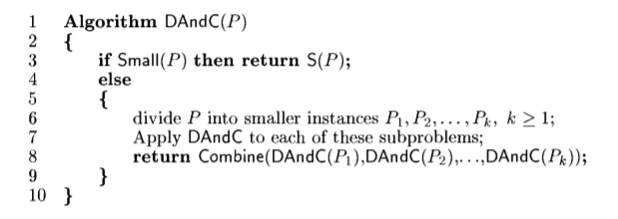

Divide and Conquer
Control abstraction for divide and conquer
The implementation of many divide and conquer algorithms is given by recursive algorithms and complexity is given by recurrence equations.

Slide 5
Recurrence Relations

Slide 6
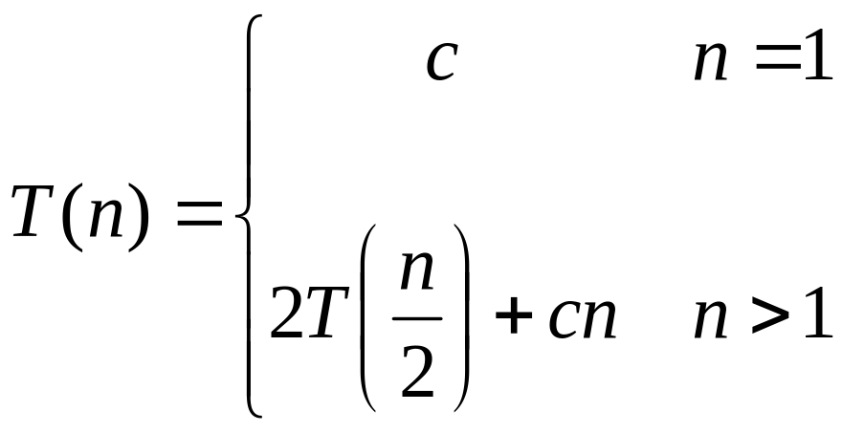
Recurrences
The expression:
is a recurrence.
  Recurrence: an equation that describes a function in terms of its value on smaller functions

Slide 7

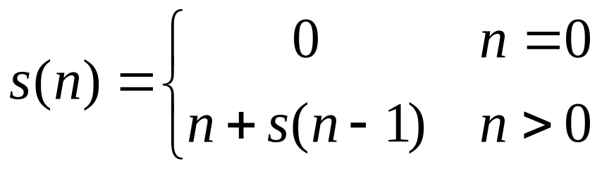

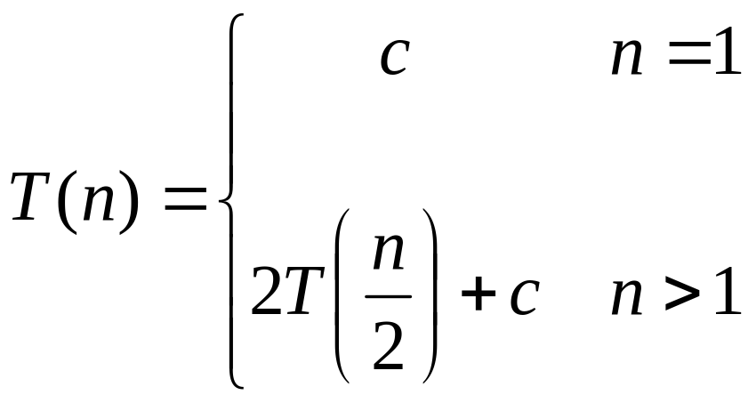
Recurrence Examples

Slide 8
Recurrence Examples
F(1)=1 n=1
F(n)= F(n-1)+1 n>1
a
b
Notes:
https://www.youtube.com/watch?v=IawM82BQ4II

Slide 9
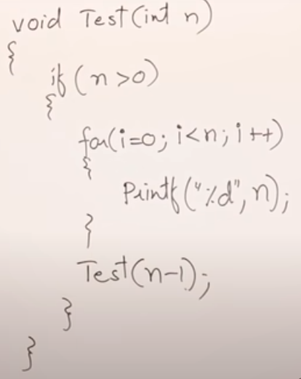
Recurrence Examples
Notes:
https://www.youtube.com/watch?v=IawM82BQ4II

Slide 10

Recurrence Examples
a
b
Example: For Binary Search
T(n) = T(n/2) + 1
Notes:
https://www.youtube.com/watch?v=IawM82BQ4II

Slide 11
Solving Recurrences
Substitution method/Iteration method
Recursion Tree
Master method

Slide 12
Solving Recurrences
The substitution method
  “Making a good guess” method
  Guess the form of the answer, then use induction to find the constants and show that solution works
  Examples:
    T(n) = 2T(n/2) + Θ(n) → T(n) = Θ(n lg n)
    T(n) = 2T(⎣n/2⎦) + 1 → ???

Slide 13
Solving Recurrences
The substitution
“Making a good guess” method
  Guess the form of the answer, then use induction to find the constants and show that solution works
  Examples:
    T(n) = 2T(n/2) + Θ(n) → T(n) = Θ(n lg n)
    T(n) = 2T(⎣n/2⎦) + 1 → T(n) = Θ(n)

Slide 14

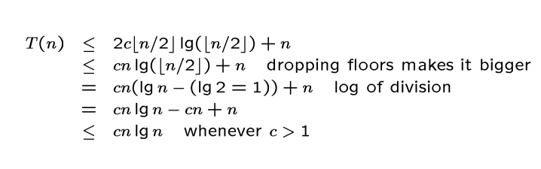
An example (Substitution method )
We guess that the solution is T(n)=Ο(n lg n).
i.e. to show that T(n) ≤ cn lg n , for some constant c> 0 and n ≥ m.
Assume that this bound holds for So , we get

Slide 15
Difficult to Guess
Try back substitution until you know what is going on
T(n/2)=2T(n/4)+n/2 substitute this in the above equation, we get
T(n) = 2( 2T(n/4)+n/2 )+n
= 4T(n/4)+n+n
= 4( 2T(n/8)+n/4 ) +2n
= 8T(n/8)+3n
= 2³T(n/2³)+3n
= …………….
= 2^{k}T(n/2^{k})+kn
In the last step n/2^{k} = 1 => k = logn (base 2)
Use this substitution
T(n)= nT(1) + logn *n
= n+nlogn (since T(1) = 1)
T(n) = O(nlogn)

Slide 16
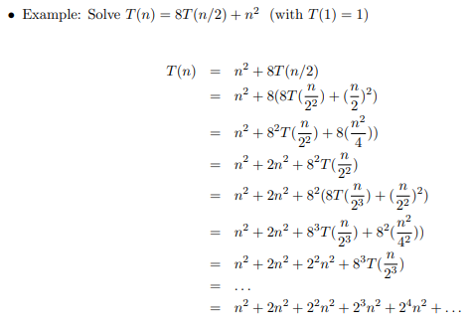

Slide 17
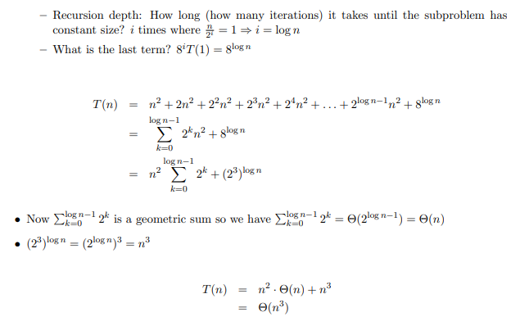

Slide 18

Change variable or ugly divide and conquer
These type recurrences are solved by using change variable methods.
For convenience we shall not worry about rounding off values, such as √n, to be integer. Renaming m=logn ( n = 2^{m} ) yields the above equation as
T(2^{m}) = 2T(2^{m/2}) + m
We can now rename S(m)=T(2^{m}) to produce the new recurrence
S(m)=2S(m/2) + m
Use substitution method for solving S(m)
S(m)=O(mlogm)
Since T(n)=T(2^{m})=S(m) = O(mlogm)= O(logn * loglogn)
Notes:
https://cs.stackexchange.com/questions/3482/changing-variables-in-recurrence-relations

Slide 19
RecursionTree Method
we draw a recurrence tree and calculate the time taken by every level of tree. Finally, we sum the work done at all levels.
To draw the recurrence tree, we start from the given recurrence and keep drawing till we find a pattern among levels.
The pattern is typically a arithmetic or geometric series.

Slide 20
Solving Recurrences using RecursionTree Method
Here while solving recurrences, we divide the problem into
subproblems of equal size.
For e.g., T(n) = a T(n/b) + f(n) where a > 1 ,b > 1 and f(n) is a given
function .
f(n) is the cost of splitting or combining the sub problems.
n
f(n) = n
T n/b
T n/b
Notes:
https://www.youtube.com/watch?v=0D2-sYen23E

Slide 21
1) T(n) = 2T(n/2) + n
The recursion tree for this recurrence is :
n
n
n/2
n/2
T(n/2)
T(n/2)
T(n/4)
T(n/4)
T(n/4)
T(n/4)

Slide 22
1) T(n) = 2T(n/2) + n
The recursion tree for this recurrence is :
n
n/2 n/2 n
log₂ n
:
:
:
n
T n/2
T n/2
n/2²
n/2²
n/2²
n/2²
n/2^{k}=1
k=logn
1
1
1
1
1
1
1

Slide 23
When we add the values across the levels of the recursion tree, we get a value of n for every level.
We have n + n + n + …… log n times
= n (1 + 1 + 1 + …… logn times)
= n (log₂ n)
= Ɵ (n log n)
T(n) = Ɵ (n log n)

Slide 24
II.
Given : T(n) = 2T(n/2) + 1
Solution : The recursion tree for the above recurrence is
1 1 2
log n 4
1
:
:
:

Slide 25
Now we add up the costs over all levels of the recursion tree, to determine the cost for the entire tree :
We get series like
1 + 2 + 2² + 2³ + …… log n times which is a G.P.
[ So, using the formula for sum of terms in a G.P. :
a + ar + ar² + ar³ + …… + ar ^{n – 1} = a( r ^{n} – 1 )
r – 1 ]
= 1 (2^{log} ^{n} – 1)
2 – 1
= n – 1
= Ɵ (n – 1) (neglecting the lower order terms)
= Ɵ (n)

Slide 26
III.
Given : T(n) = T(n/3) + T(2n/3) + n
Solution : The recursion tree for the above recurrence is
n
n/3 2n/3 n
log₃ n log_{3/2} n
n
1 n/3^{i}
:
:
:
n
n/3
2n/3
n
3²
2 n
3 3
1 2n
3 3
n .
(3/2)²

Slide 27
When we add the values across the levels of the recursion tree , we get a value of n for every level.
Since the shortest path from the root to the leaf is
n → n → n → n → …. 1
3 3² 3³
we have 1 when n = 1
3^{i}
=> n = 3^{i}
Taking log₃ on both the sides
=> log₃ n = i
Thus the height of the shorter tree is log₃ n
T(n) > n log₃ n … A

Slide 28
Similarly, the longest path from root to the leaf is
n → 2 n → 2 ² n → … 1
3 3
So rightmost will be the longest
when 2 ^{k} n = 1
3
or n = 1
(3/2)^{k}
=> k = log_{3/2} n
T(n) < n log_{3/2} n … B
Since base does not matter in asymptotic notation , we guess
from A and B
T(n) = Ɵ (n log₂ n)

Slide 29
The Master Theorem
Given: a divide and conquer algorithm
  An algorithm that divides the problem of size n into a subproblems, each of size n/b
  Let the cost of each stage (i.e., the work to divide the problem + combine solved subproblems) be described by the function f(n)
Then, the Master Theorem gives us a “cookbook” for the algorithm’s running time.

Slide 30
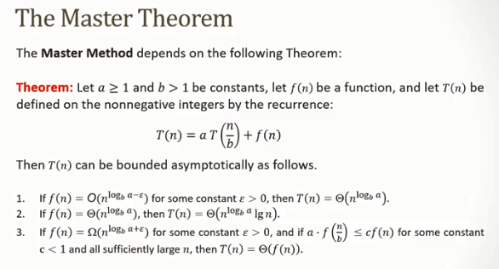

Slide 31
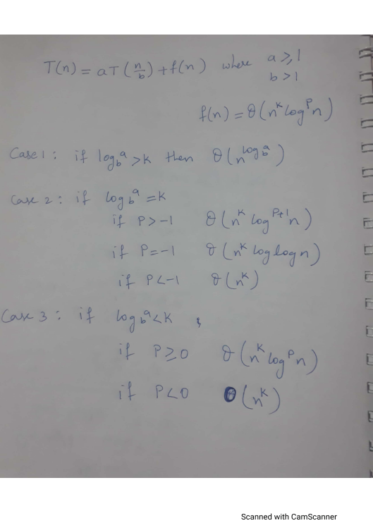
The Master Theorem

Slide 32
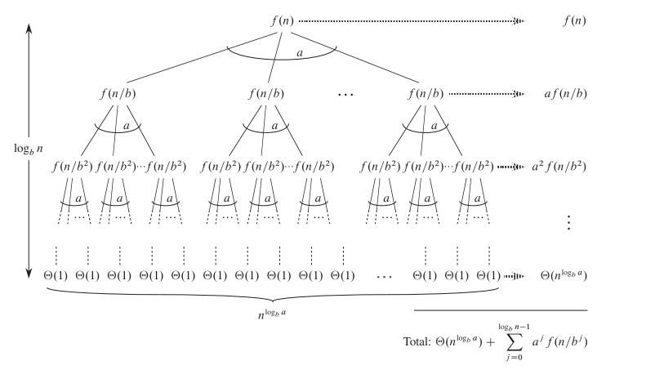
T(n)=aT(n/b)+f(n)
In terms of the recursion tree, the three cases of the master theorem correspond
to cases in which the total cost of the tree is (1) dominated by the costs in the
leaves, (2) evenly distributed among the levels of the tree, or (3) dominated by the
cost of the root.
Notes:
https://www.youtube.com/watch?v=zbf0llo3-YI

Slide 33
Examples of Master’s Theorem
T(n) = 3T(n/5) + n
T(n) = 2T(n/2) + n
T(n) = 2T(n/2) + 1
T(n) = T(n/2) + n
T(n) = T(n/2) + 1
T(n) = 2T(n/2) + n logn
T(n) = 2T(n/2) + n/ logn

Slide 35
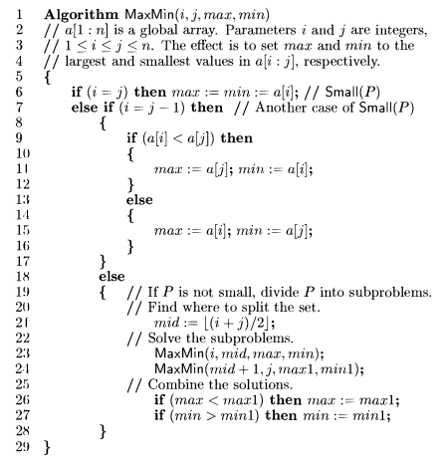

Slide 36

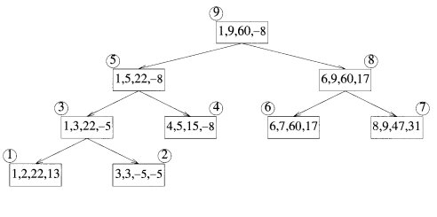

Slide 37
